Slide 1
SMART FALL DETECTION AND EMERGENCY ALERT System
Presented By: Fiza Ashiq ,Fairha Tayyab
Submitted to: Sir Faisal Hafeez
Roll number: BSITM_SECB_90,80
subject: Mobile Application developmen

Slide 2
SafeFall
The Smart Fall Detection & Emergency Alert System is an Android application designed to improve the safety of elderly people and patients. The app automatically detects falls, sends emergency alerts with live location to caretakers, and also provides a manual SOS feature for emergency situations.

Slide 3
Features
Automatic Fall Detection
5-Second “I Am Okay” Confirmation
Emergency Alert Sending
Live GPS Location Sharing
Manual SOS Emergency Button
Caretaker Linking Through Unique ID
Alert History Management
Edit/Delete Caretaker & Alerts

Slide 4
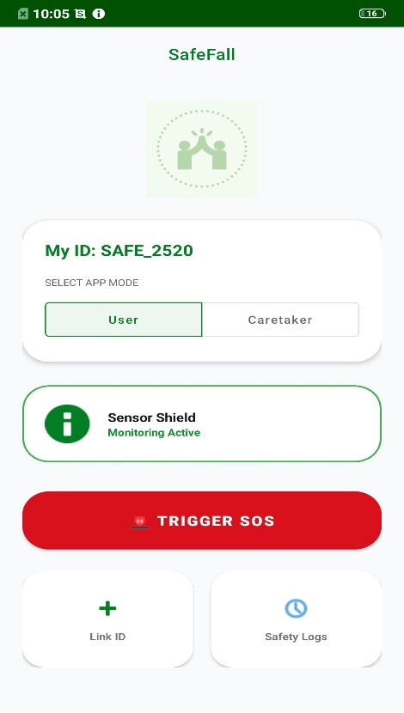
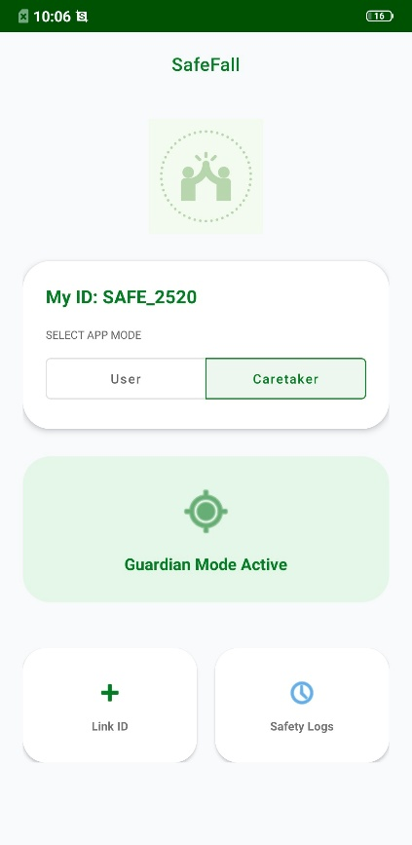
Working of the App
How the Application Works
Application continuously monitors user movement
If a fall is detected, a 5-second popup appears
User can press “I Am Okay” to cancel alert
If no response is received:
Emergency alert is sent
Live location is shared with caretaker
User can also manually send SOS alert anytime

Slide 5
Technologies & Algorithm
Technologies Used
Android Studio
Java & XML
Firebase Database
GPS Location Services
Accelerometer Sensor
Algorithm Used
Threshold-Based Fall Detection Algorithm
Detects:
Sudden acceleration
Abnormal movement
Possible falls

Slide 6
Limitations
Requires internet/GPS for location sharing
Battery consumption due to continuous sensor monitoring
Accuracy depends on mobile sensor quality
If the mobile phone is far from the user, fall detection may not work accurately

Slide 7
Future Work
Smartwatch Integration for better fall detection
AI-Based Accurate Fall Prediction
Voice Command Emergency Activation
Emergency Calling Feature
Hospital & Ambulance Integration
Wearable device support to detect falls even when the phone is far away

